Slide 1
﻿LLM-Guided Counterfactual Data Generation for Fairer AI
ACM WWW’24
Hewlett Packard India

Slide 2
Overview
A 35-year-old African American man
Education: BS in Computer Science
Experience: 5 years of relevant work experience
Skills: Proficient in required programming languages
Model's Decision: Reject the candidate, ranking him 20th out of 100 applicants.
Unfair decision
Biased model
model's decision-making process is not transparent,
produces discriminatory outcome
Bias due to model
Bias due to dataset
Fails to capture the correlation with qualification
Imbalanced data, biased labeling, lack of diversity

Slide 3
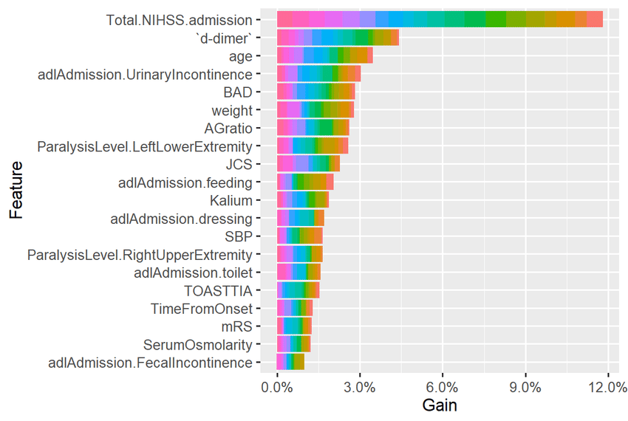
Terminologies
Model explanations
Counterfactual explanations
“If you had a better income, you could’ve got the lone”

Slide 4
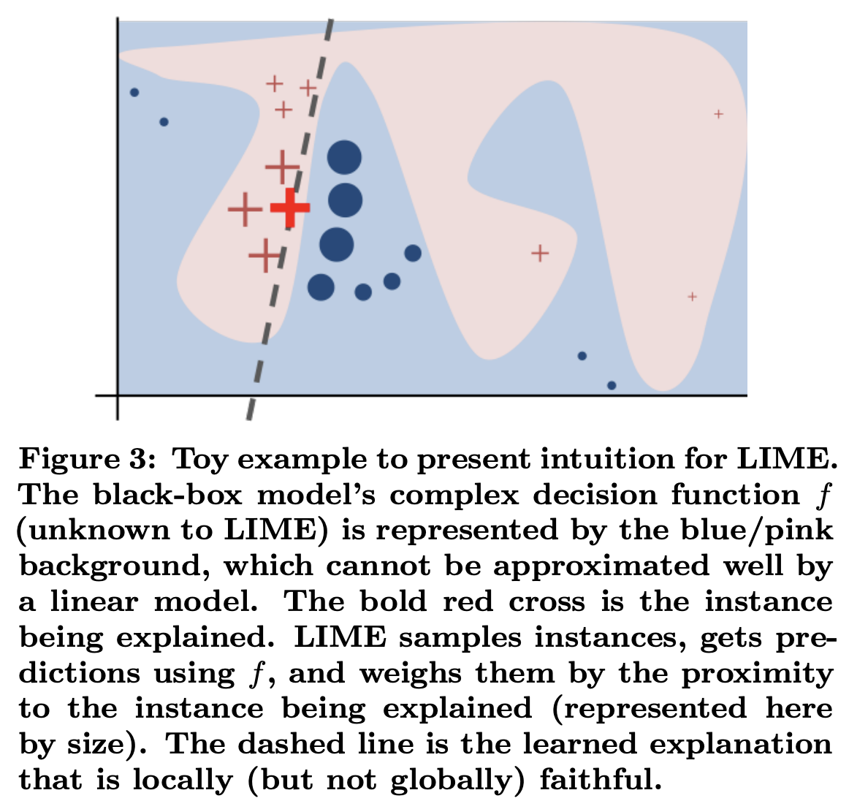
Tools
Model explanations
LIME
SHAP

Slide 5
Tools
Sample Input
Dataset: Adult Income Dataset (a sample dataset in AIF360)
Protected Attribute: sex (binary, 0 for female, 1 for male)
Target Variable: income (binary, 0 for <=50K, 1 for >50K)
Model: Tensorflow, PyTorch, Scikit-Learn any model
Bias estimator
AIF-360
Sample Output
Disparate Impact: 0.65 (indicates bias in the model, as the ratio of favorable outcomes for the protected group is less than 0.8)
Equal Opportunity Difference: 0.12 (indicates bias in the model, as the difference in true positive rates between the protected groups is greater than 0.1)

Slide 6
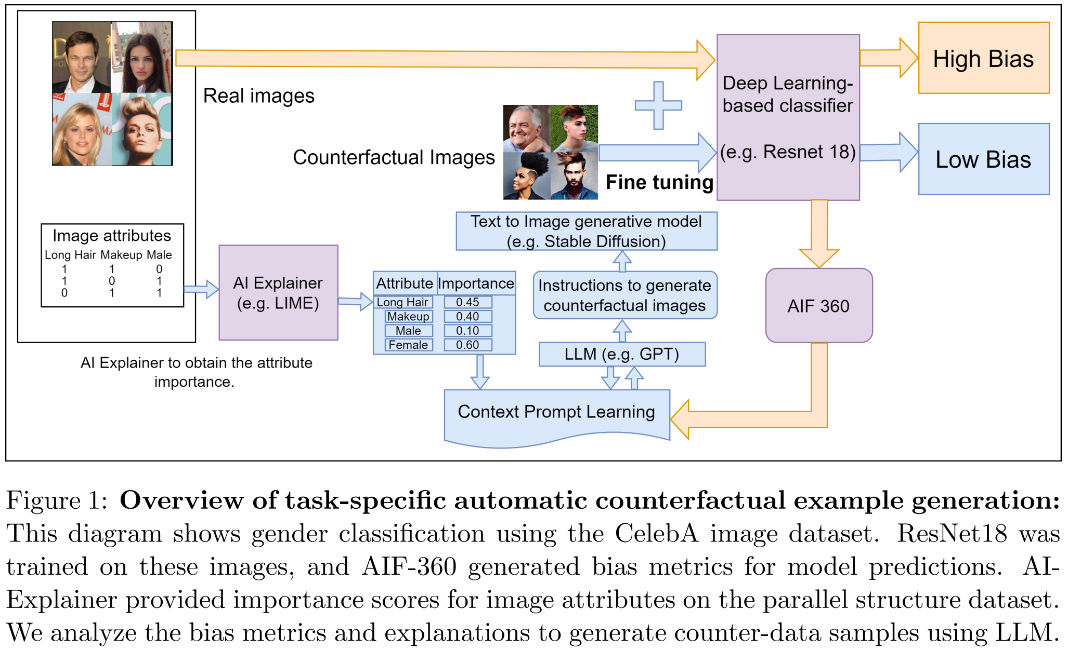
Methodology

Slide 7

LLM and GenAI
Prompt
﻿P = {T, Acc, M, P_{att}, A, S}
T = task
Acc = model accuracy
M = bias metrics from AIF-360
P_{att} = protected attributes
A = list of attributes
S = feature importance
﻿t_{i} = LLM(P, Q)
﻿t_{i} = text for generating a CF for the i^{th} class
Q = Associated query
﻿$\hat{x_{i}}$ = G_{ϕ}(t_{i}, t_{n})
G_{ϕ} = Diffusion model for image generation

Slide 8
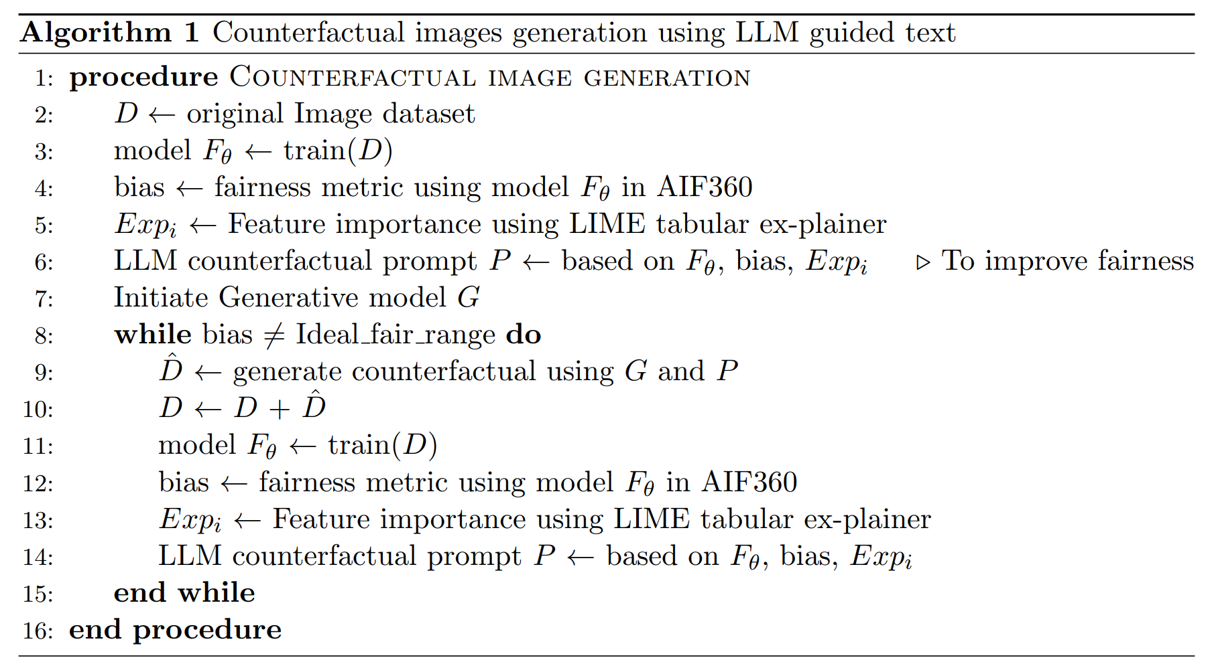
Algorithm

Slide 9
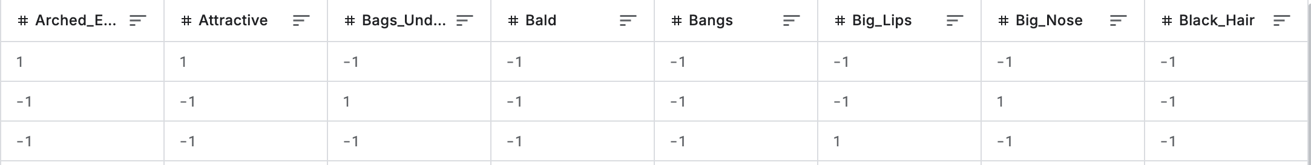
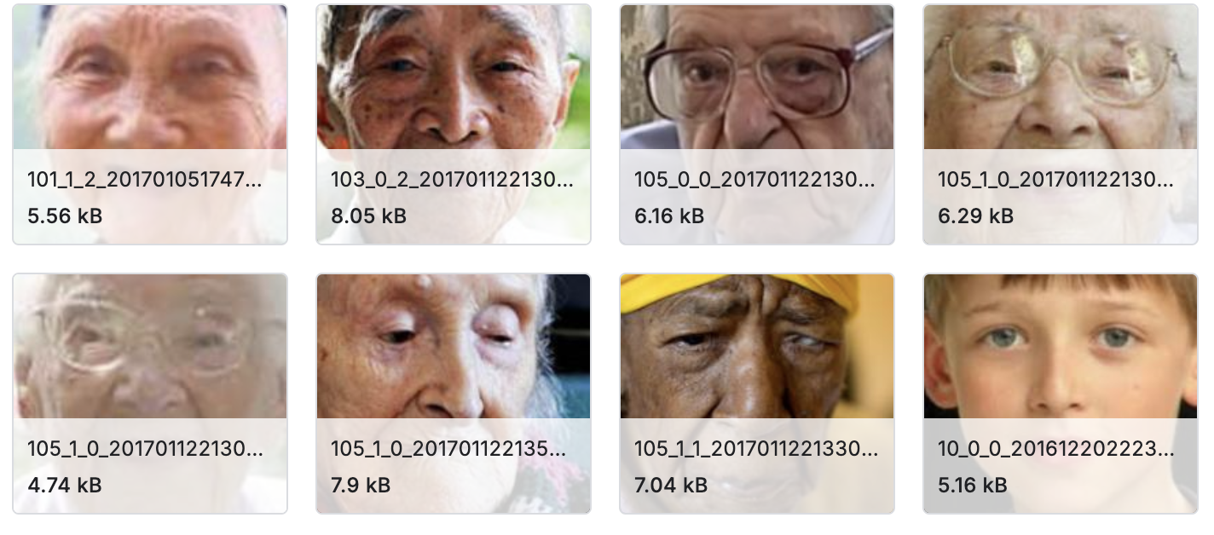
Datasets
CelebA dataset
202,599 number of face images of various celebrities
10,177 unique identities, but names of identities are not given
40 binary attribute annotations per image like ﻿gray hair, male, pale skin, bald etc
5 landmark locations
UTKface
20,000 face images with annotations of age, gender, and ethnicity.

Slide 10

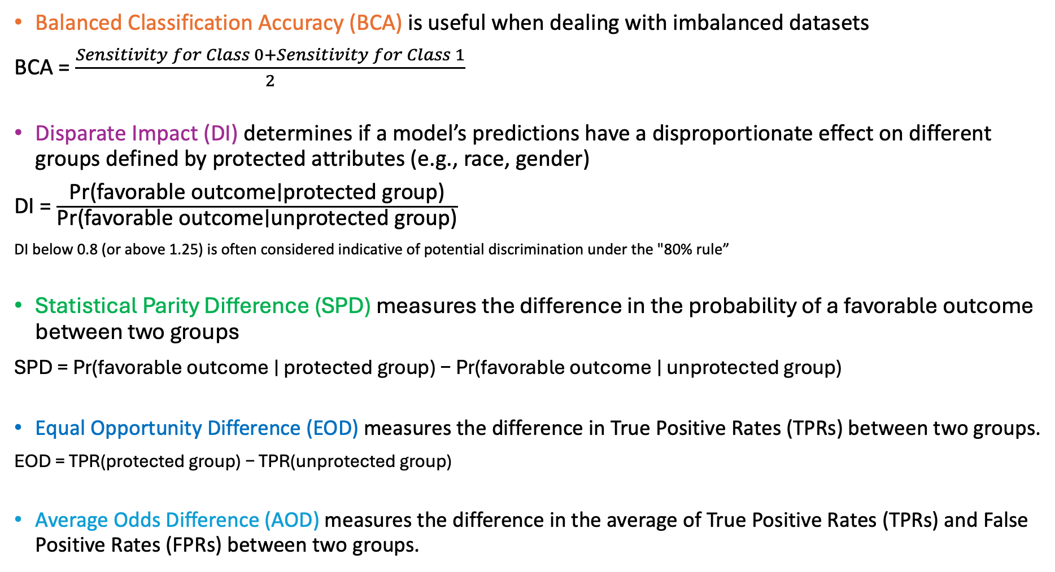
Balanced Classification Accuracy (BCA) is useful when dealing with imbalanced datasets
BCA = $\frac{Sensitivity for Class 0+Sensitivity for Class 1​}{2}$
Disparate Impact (DI) determines if a model’s predictions have a disproportionate effect on different groups defined by protected attributes (e.g., race, gender)
DI = $\frac{\text{Pr}\text{(}\text{favorable} \text{outcome}\text{∣}\text{protected} \text{group}\text{)}}{\text{Pr}\text{(}\text{favorable} \text{outcome}\text{∣}\text{un}\text{protected} \text{group}\text{)}}$
DI below 0.8 (or above 1.25) is often considered indicative of potential discrimination under the "80% rule”
Statistical Parity Difference (SPD) measures the difference in the probability of a favorable outcome between two groups
SPD = Pr(favorable outcome ∣ protected group) − Pr(favorable outcome ∣ unprotected group)
Equal Opportunity Difference (EOD) measures the difference in True Positive Rates (TPRs) between two groups.
EOD = TPR(protected group) − TPR(unprotected group)
Average Odds Difference (AOD) measures the difference in the average of True Positive Rates (TPRs) and False Positive Rates (FPRs) between two groups.
$$AOD= \frac{1}{2}\text{((}\text{TPR}\text{(}\text{protected} \text{group}\text{)−}\text{TPR}\text{(}\text{unprotected} \text{group}\text{))+(}\text{FPR}\text{(}\text{protected} \text{group}\text{)−}\text{FPR}\text{(}\text{unprotected} \text{group}\text{)))}$$

Slide 11
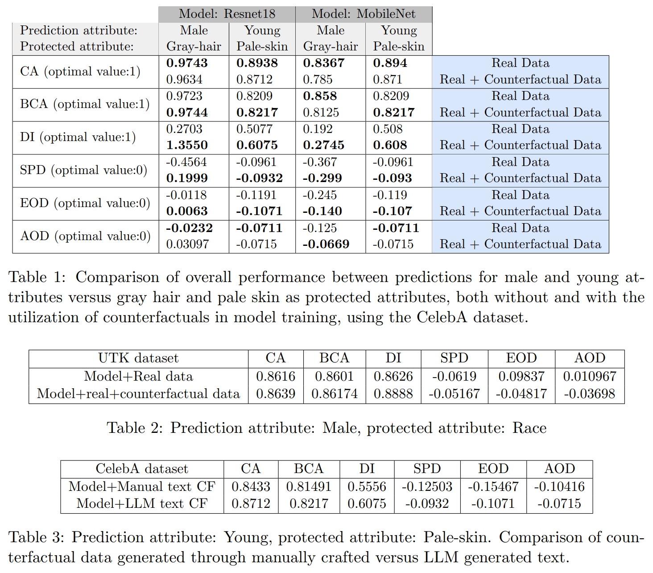
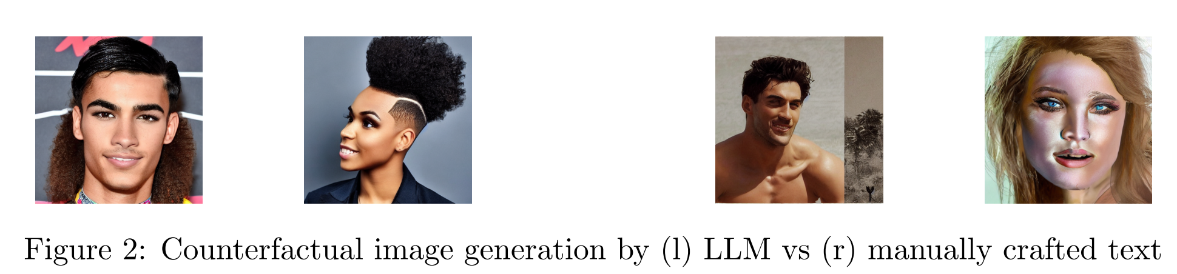
Results
Generated with LLM instructions
Generated with human instructions

Slide 12
